Slide 1

Alternate Career Planner
Emily Constantin, Kale Dodson, Beatrice Eldridge, Jack Minehan, Ryan Perry

Slide 2
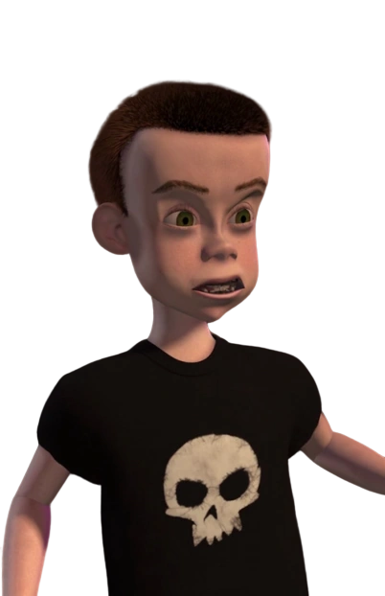

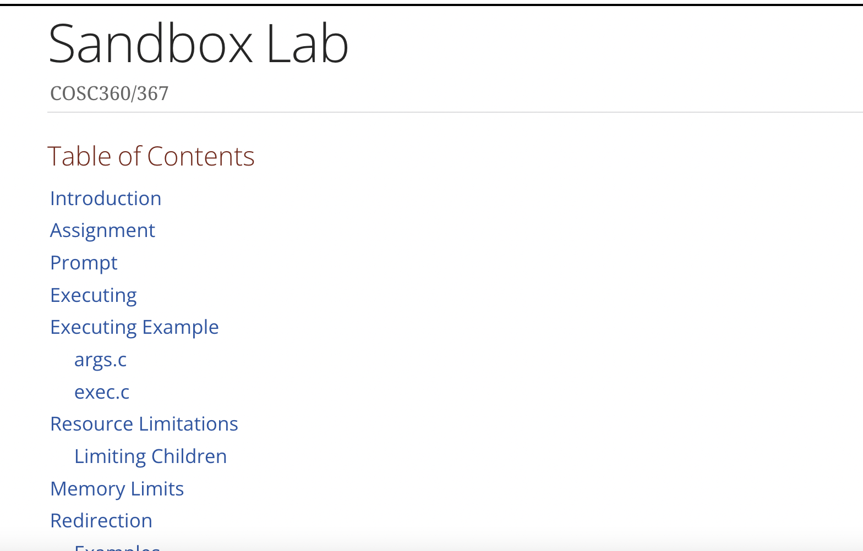
Problem Statement
What problem plagues Sid every day?
Notes:
Beatrice
He really dislikes his major. Half his time is spent doing his hw and the other half he spends hating it
He tries to run his dars but he has to manually select a different major but he doesnt know which one he would like, all he knows is he wants to switch
Also when he manually selects a major he has to manually calculate how many hours he has left in it so it takes a lot of effort

Slide 3
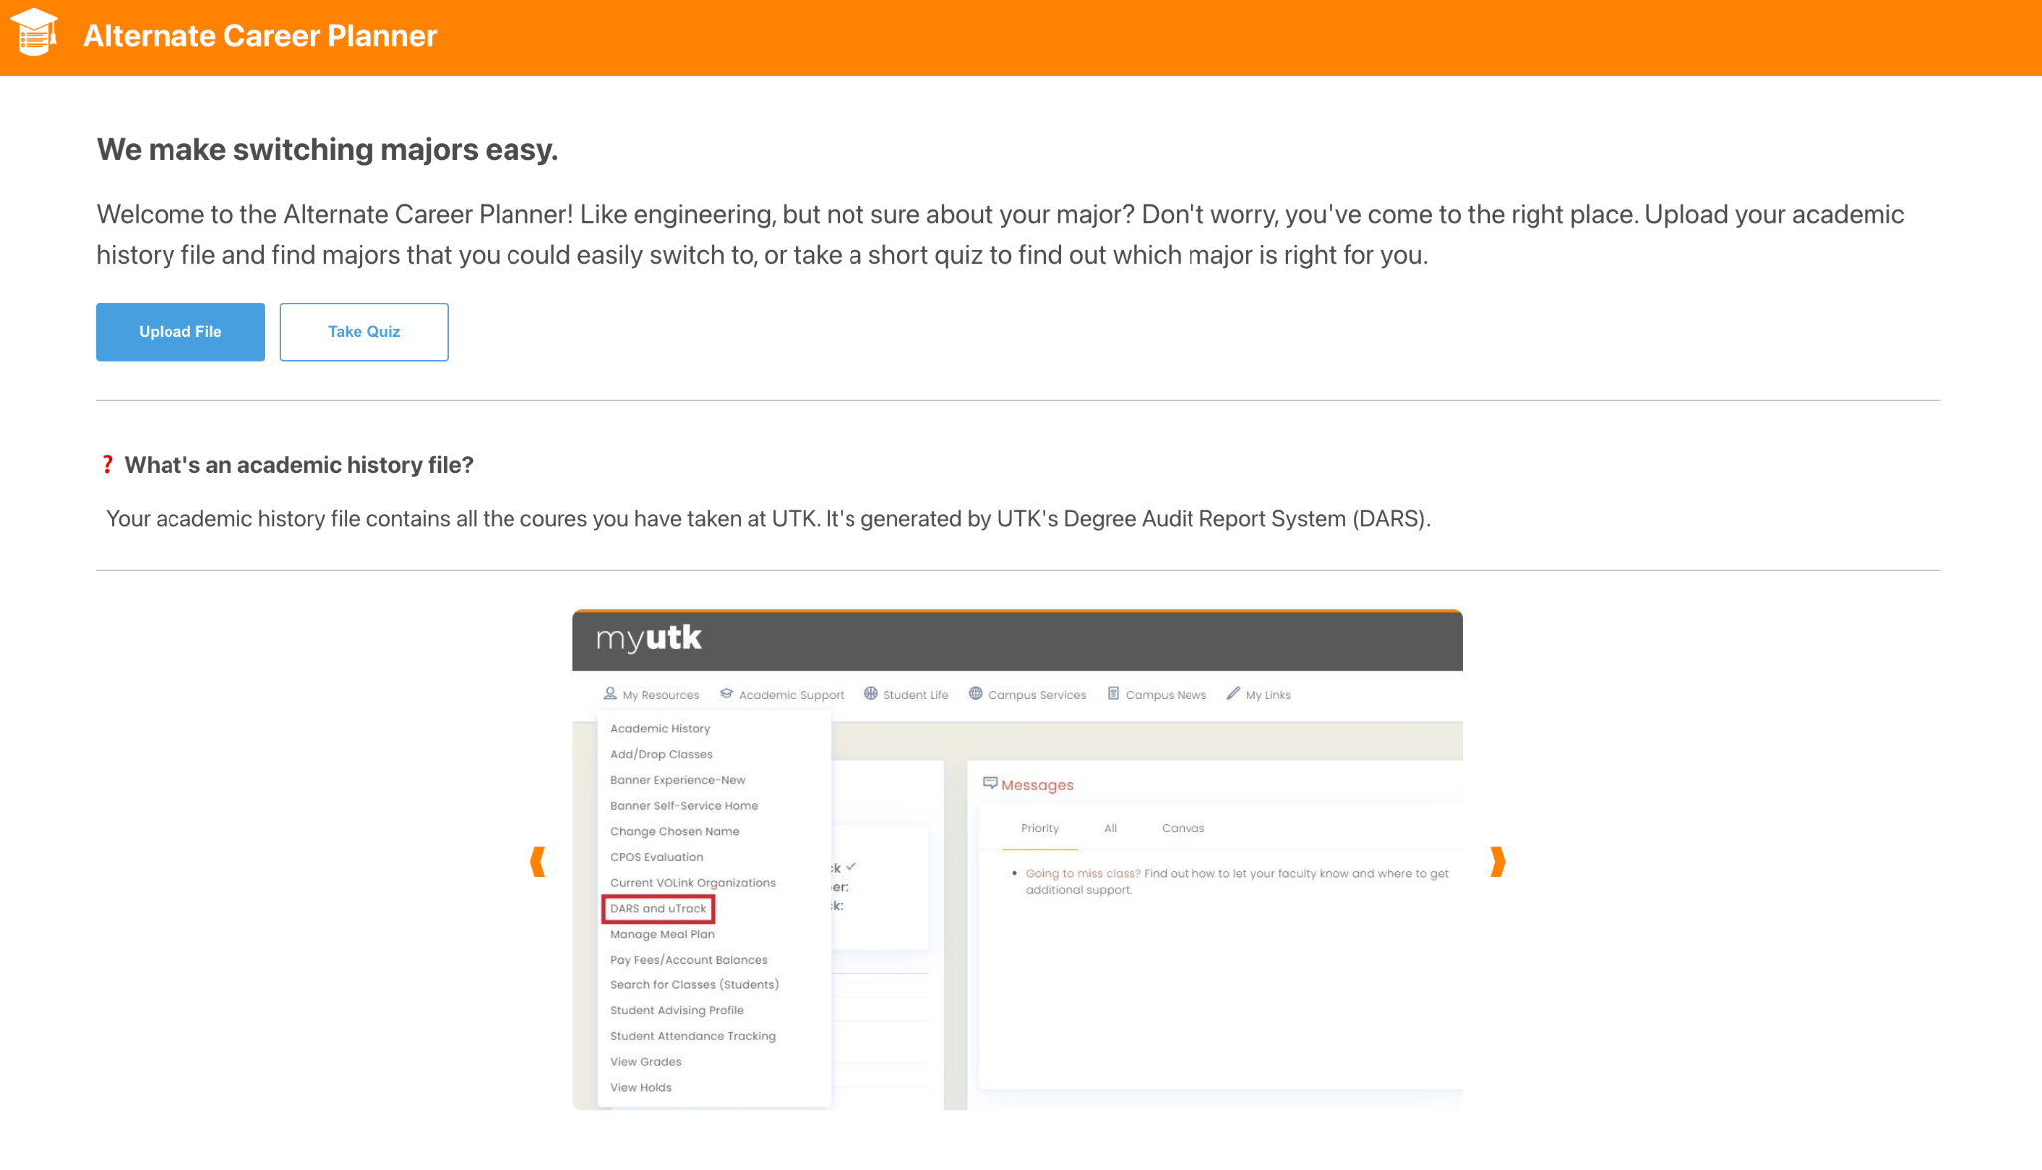
Project Summary
Take an Interest Quiz
Upload Your Course History
See personalized Top 3 Engineering majors
Learn about other Engineering careers
Notes:
beatrice

Slide 4





Tools
Notes:
Emily
React - front end
Javascript
Html
Css
Python
Flask to connect front end to back end
Excel
Privacy in mind
static data
no user data saved

Slide 5
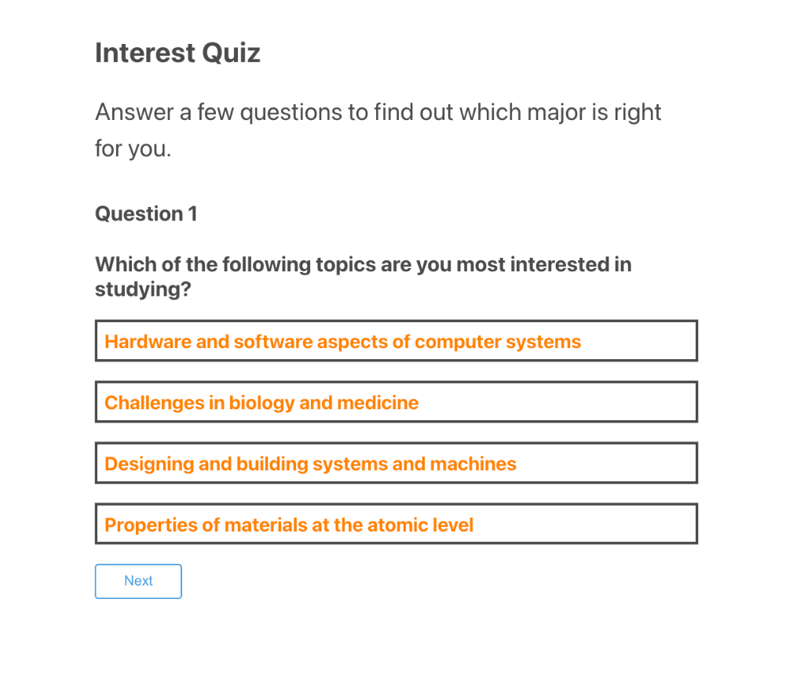
Take The Quiz
Notes:
Ryan
Given questions that are used to determine what major is best fit
Questions change based on the answer to the previous question

Slide 6
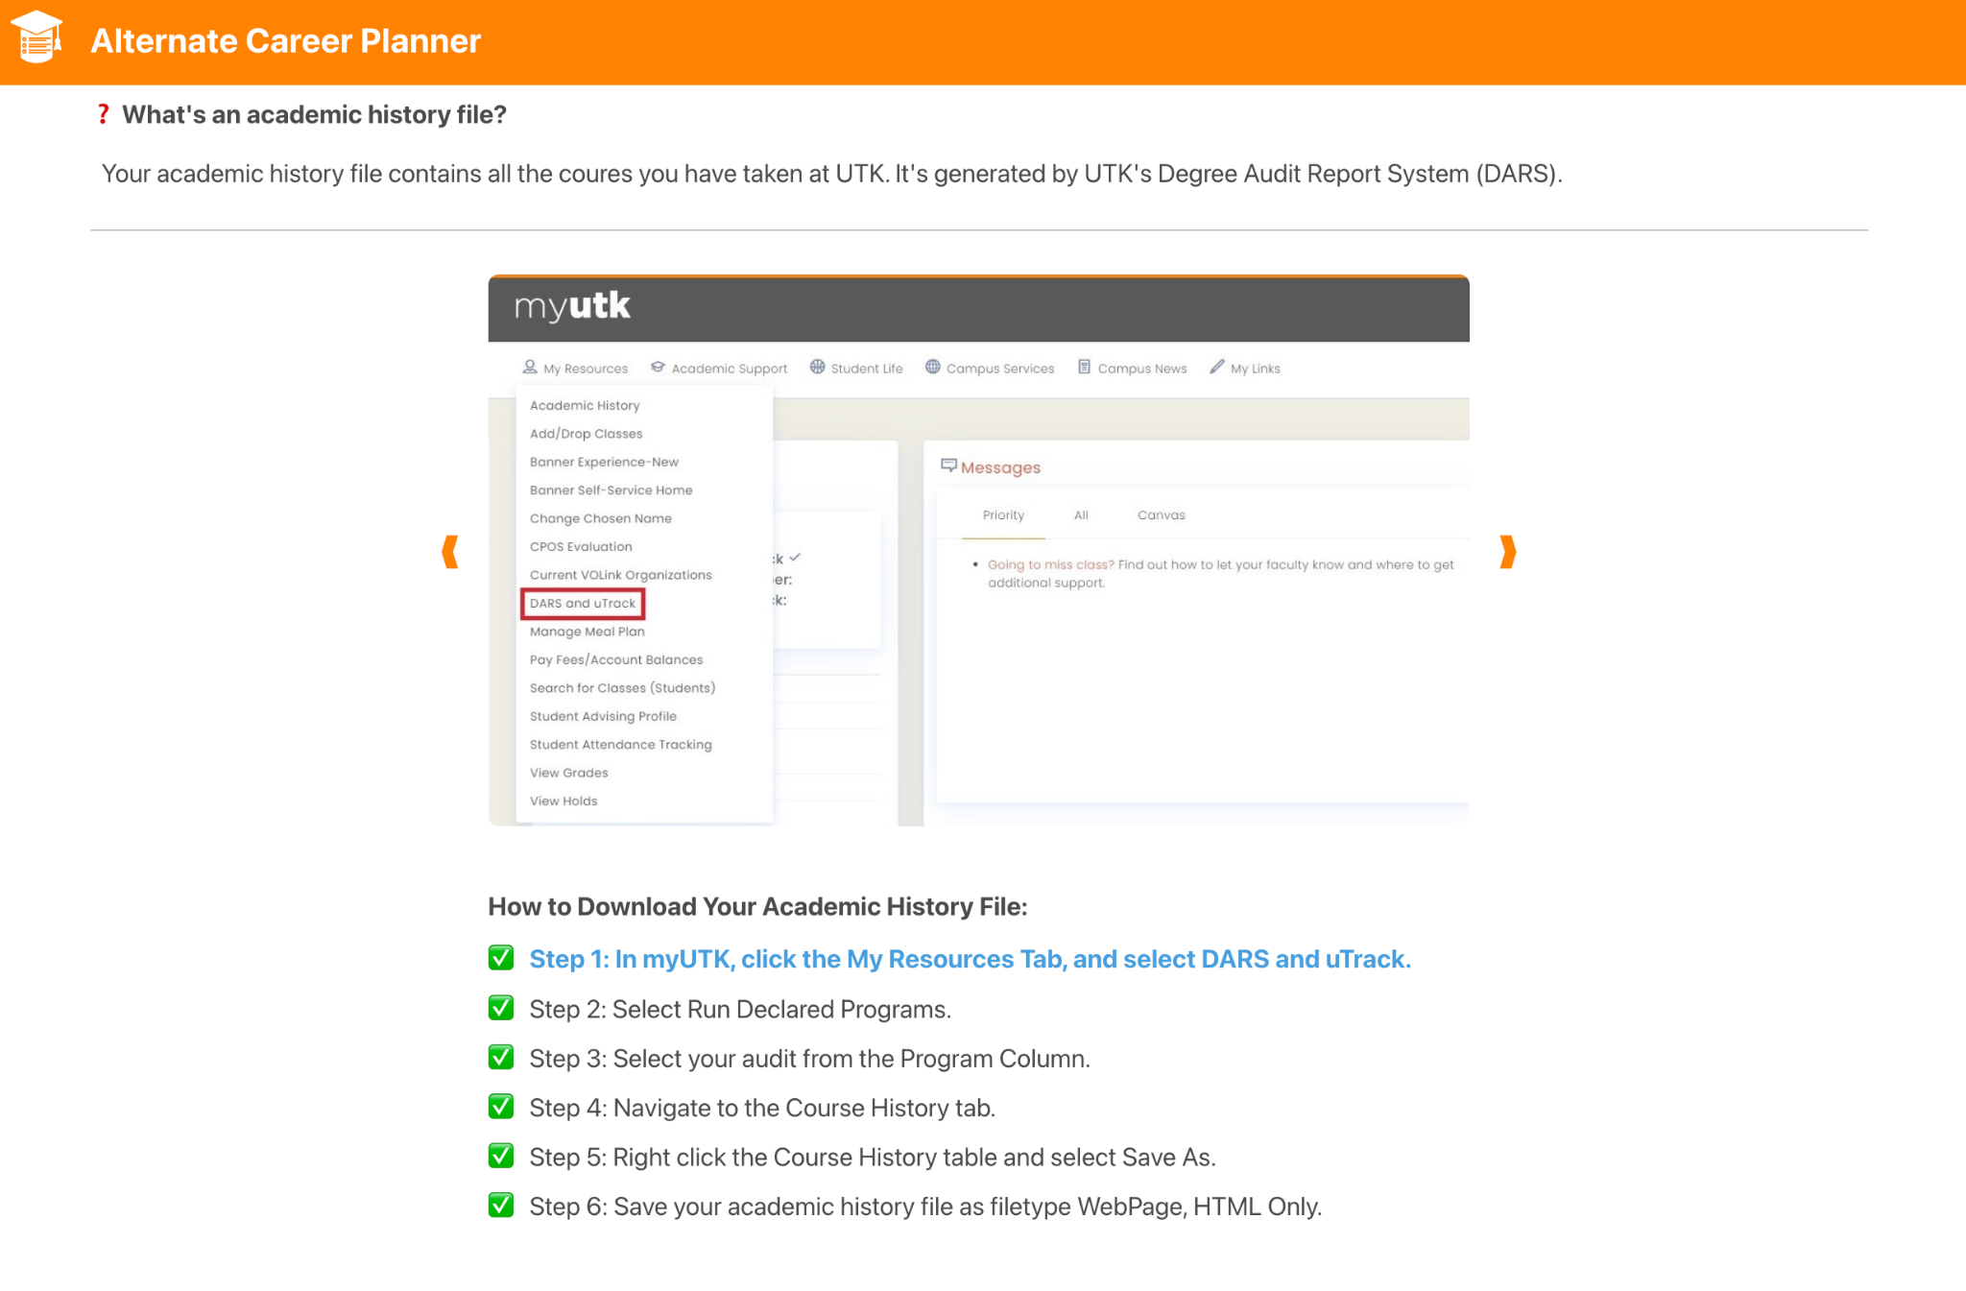
Upload Process
Notes:
Ryan
Upload the html file from the DARS report
Give step by step instructions on the website on how to upload
Only need to upload one html file for the process to work

Slide 7
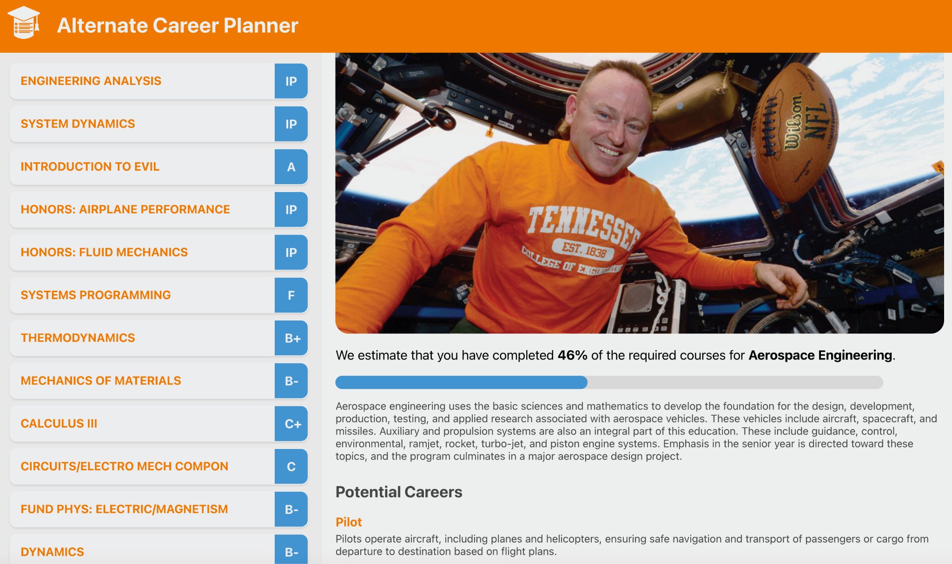
Suggested Majors and Course History
Notes:
Jack
View entire course history and grades
Displays 3 majors closest to completion
Shows percentages,
descriptions,
images,
careers
Unique courses for that major

Slide 8
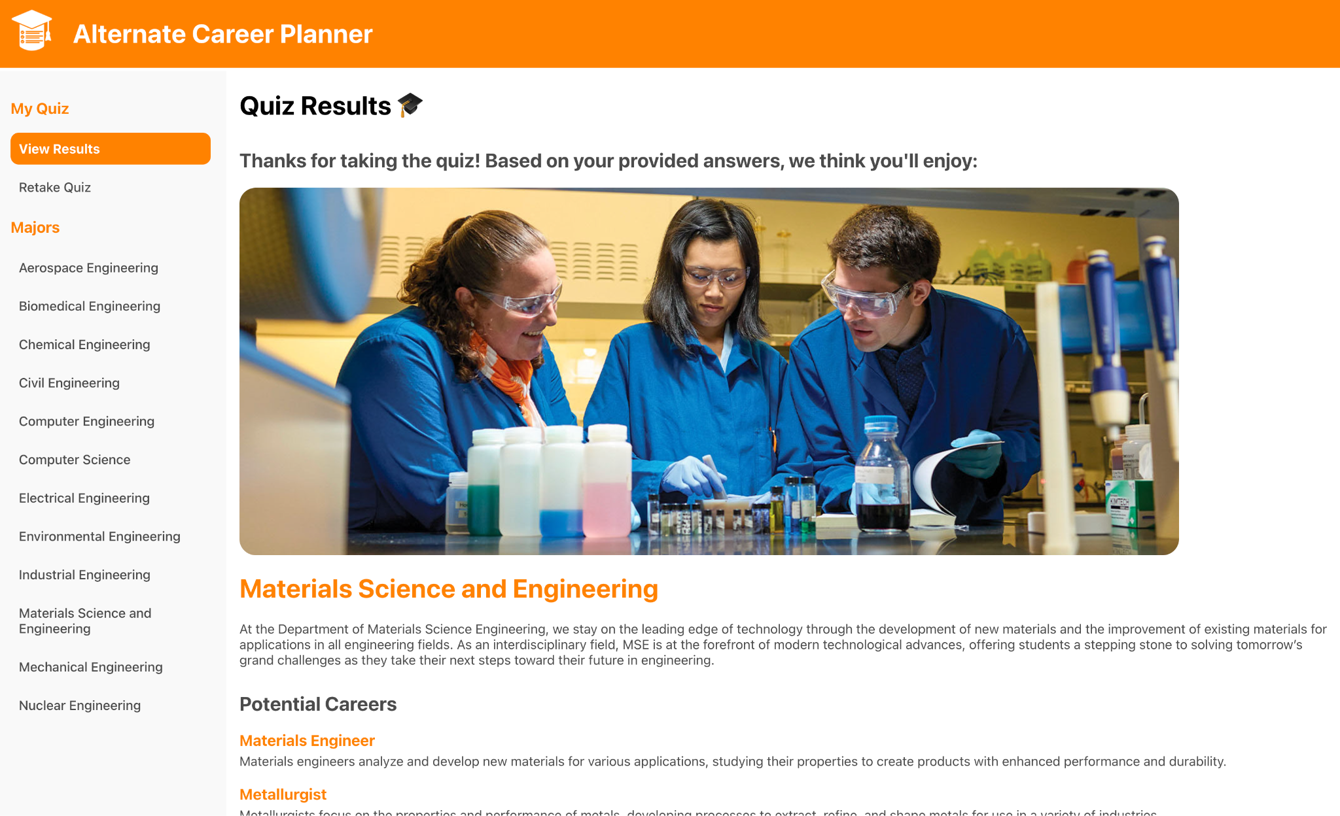
Quiz Results
Notes:
Emily
After finishing a brief career quiz
Quiz results page
Matched with majors you might enjoy
Options for potential careers that you can explore with that major
Navigation pane allows you to look at
Majors
descriptions
Potential careers
specific courses in those majors
Description, courses, and careers
Showcases colors matching utk and navigation bar
Cite images and descriptions from utk website

Slide 9
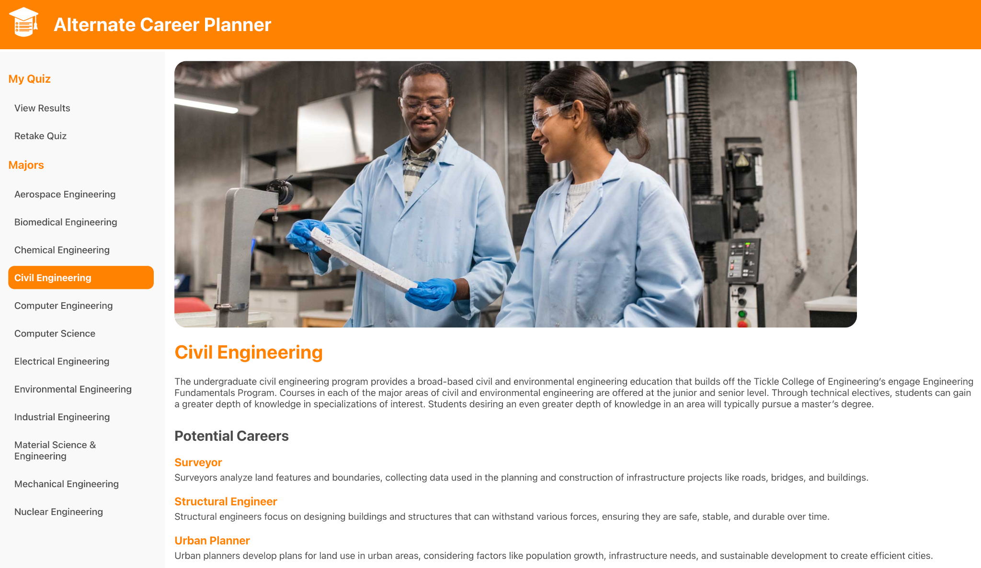
Exploring Other Majors
Notes:
Jack
Navigate sidebar to view other majors
Each have their own unique header image
Descriptions
Potential Careers
Courses

Slide 10
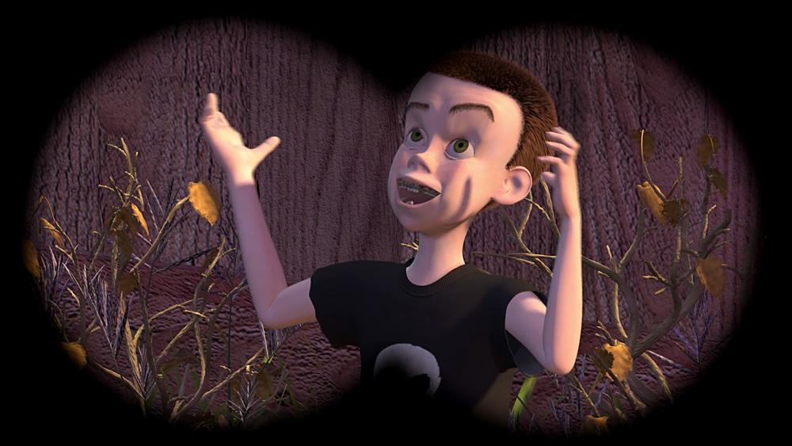
Live Demo - Let’s Save Sid
Notes:
Kale
Animated characters to be the student - sid from toy story
Let’s save sid!

